Slide 1
INSTACART
Grocery App
Market Basket Analysis
Hiromi Nakashima, m20201025
Manuel A. F. Carreiras, m20200500
Luis F. R. Agottani, m 20200621
Venâncio Munhangane, m20200579

Slide 2
AGENDA FOR TODAY
BUSINESS UNDERSTANDING
CLUSTERING
MARKETING BASKET ANALYSIS
CONCLUSIONS

Slide 3
BUSINESS UNDERSTANDING

Slide 4
BUSINESS GOALS
Identify correlation/patterns of shopping between the products
Identify substitutes/
complementary products
Create customers profiles of shopping.
Develop a market basket analysis
Measure association rules metrics
Clustering the carts to identify shopping patterns.
DATA MINING

Slide 5
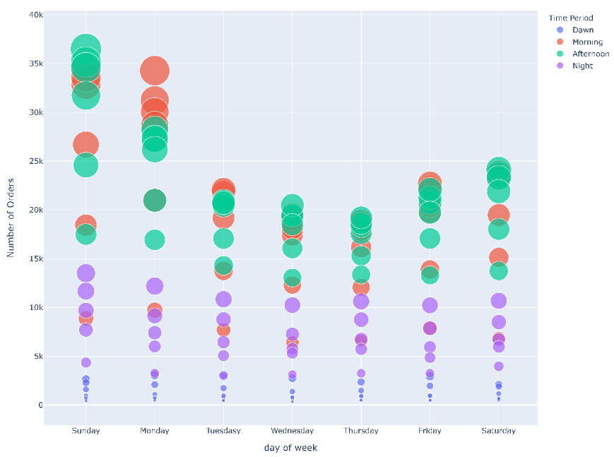
BUSINESS UNDERSTANDING
Orders/Period
Blue are the best days and red the worse.

Slide 6
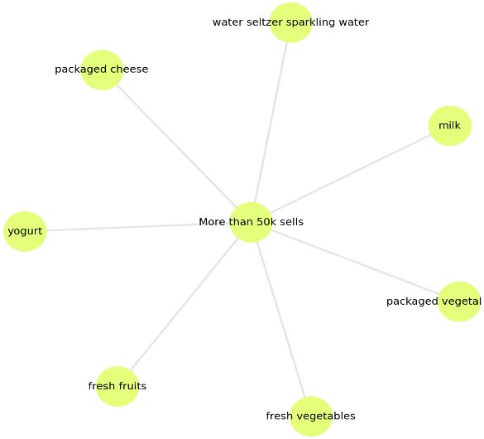
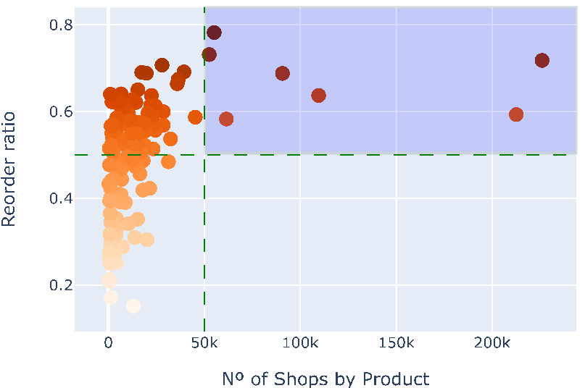
BUSINESS UNDERSTANDING
Orders/Period
High sales products
Despite being red, Mars is actually a cold place full of iron oxide dust

Slide 7
CLUSTERING

Slide 8
CLUSTER 1
CLUSTER 2
CLUSTER 3
CLUSTER 4
CLUSTER 5
fresh fruits
fresh vegetables
yogurt
packaged vegetables fruits
water seltzer sparkling water
paper goods
packaged cheese
chips pretzels
refrigerated
milk
fresh vegetables
fresh fruits
packaged vegetables fruits
yogurt
packaged cheese
milk
chips pretzels
water seltzer sparkling water
soy lactosefree
frozen produce
fresh vegetables
fresh fruits
packaged vegetables fruits
yogurt
hot dogs bacon sausage
packaged cheese
milk
water seltzer sparkling water
chips pretzels
bread
fresh fruits
fresh vegetables
packaged vegetables fruits
yogurt
water seltzer sparkling water
milk
packaged cheese
chips pretzels
soy lactosefree
refrigerated
fresh vegetables
fresh fruits
packaged vegetables fruits
yogurt
packaged cheese
milk
chips pretzels
bread
frozen produce
soy lactosefree

Slide 9
MARKET BASKET ANALYSIS

Slide 10
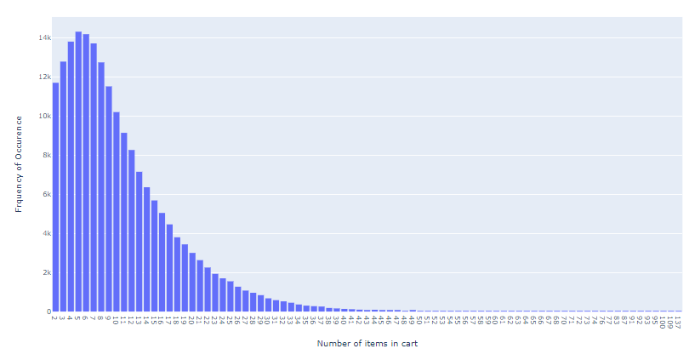
SIZE OF THE BASKET
High frequency = 5 products per order

Slide 11
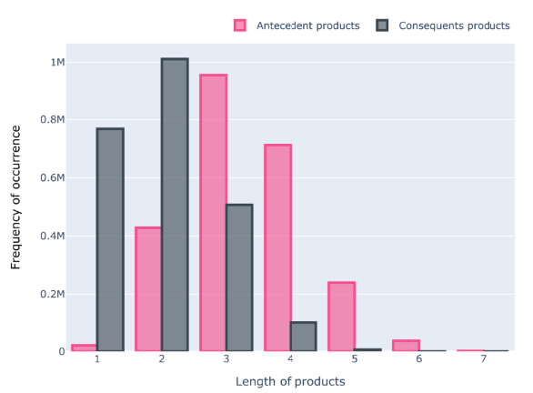
MOST FREQUENTLY QUANTITY PURCHASED
Antecedent = 3
Consequents = 2

Slide 12
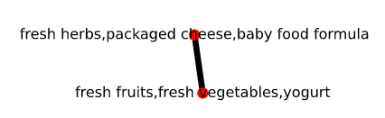
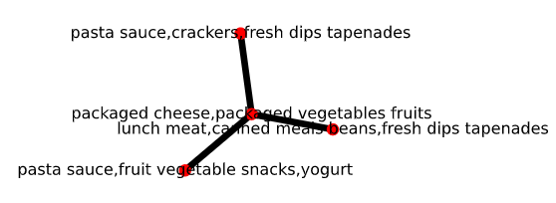
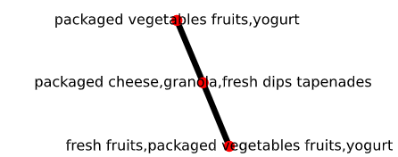

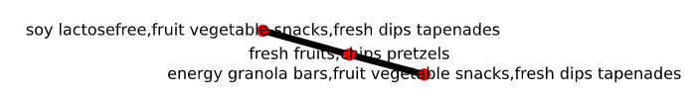

TOP 10 COMPLEMENTARY PRODUCTS
Confidence >= 0.5
Lift >= 1.8

Slide 13
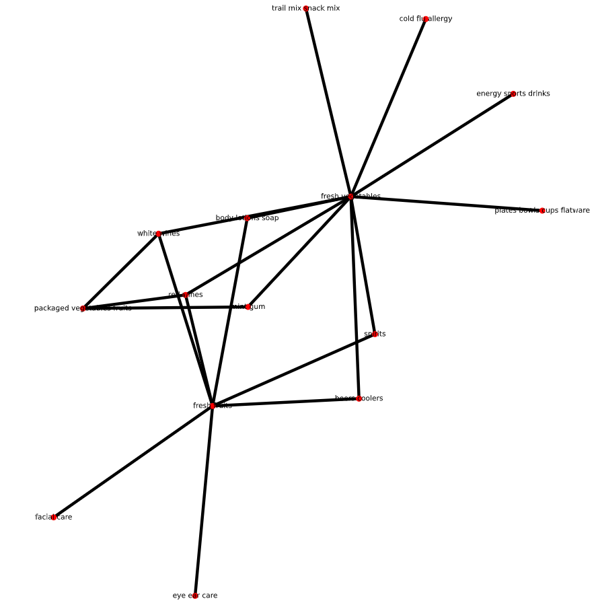
TOP 20 SUBSTITUTES PRODUCTS
Confidence >= 0.2
Lift < 0.9

Slide 14
CONCLUSION

Slide 15
CONCLUSION - CLUSTER
All the clusters show a high interest in fruits and vegetables.
Based on the Market Basket Analysis we reached that the customers look for Instacart order with 3 products (antecedents), although promotions support them to buy more and reach the average of purchases of 5 products per order.
The 7 most buying products should be the main focus on sales to provide the increase sales of the associated products.

Slide 16
THANK YOU!

